Slide 1

Gemini-Powered RAG System for Intelligent Document Search
An overview of our new API for Retrieval-Augmented Generation
Presenter: Madhusudan Nayak
Date: [Date]

Slide 2
Agenda
1
The Problem
How do we find answers within our growing library of documents?
2
The Solution
An overview of Retrieval-Augmented Generation (RAG).
3
System Architecture
A high-level look at the components.
4
Core Engine (rag_google.py)
How the "magic" happens.
Ingestion, Chunking, and Vectorization
Smart Retrieval and PII Masking
5
API Layer (app_google.py)
How we interact with the system.
Key Endpoints: /upload, /query, /delete
6
Key Feature: Automated Indexing
Keeping our knowledge base fresh.
7
Live Demo / Workflow
Putting it all together.
8
Next Steps & Q&A

Slide 3

The Problem: Unstructured Data Overload
Our organization has a large and growing number of documents (.pdf, .docx, etc.).
Finding specific information is time-consuming and inefficient.
Simple keyword searches often miss context and fail to provide direct answers.
Question: How can we enable users to ask natural language questions and get direct, accurate answers from our documents?

Slide 4




The Solution: Retrieval-Augmented Generation (RAG)
We've built a system that combines two powerful AI techniques:
Retrieval
A specialized database (ChromaDB) finds the most relevant text snippets from our documents based on the user's query.
Generation
A powerful Large Language Model (Google's Gemini 1.5 Flash) uses these snippets as context to generate a concise, human-like answer.
It's like an open-book exam for an AI—it finds the facts first, then formulates the answer.

Slide 5
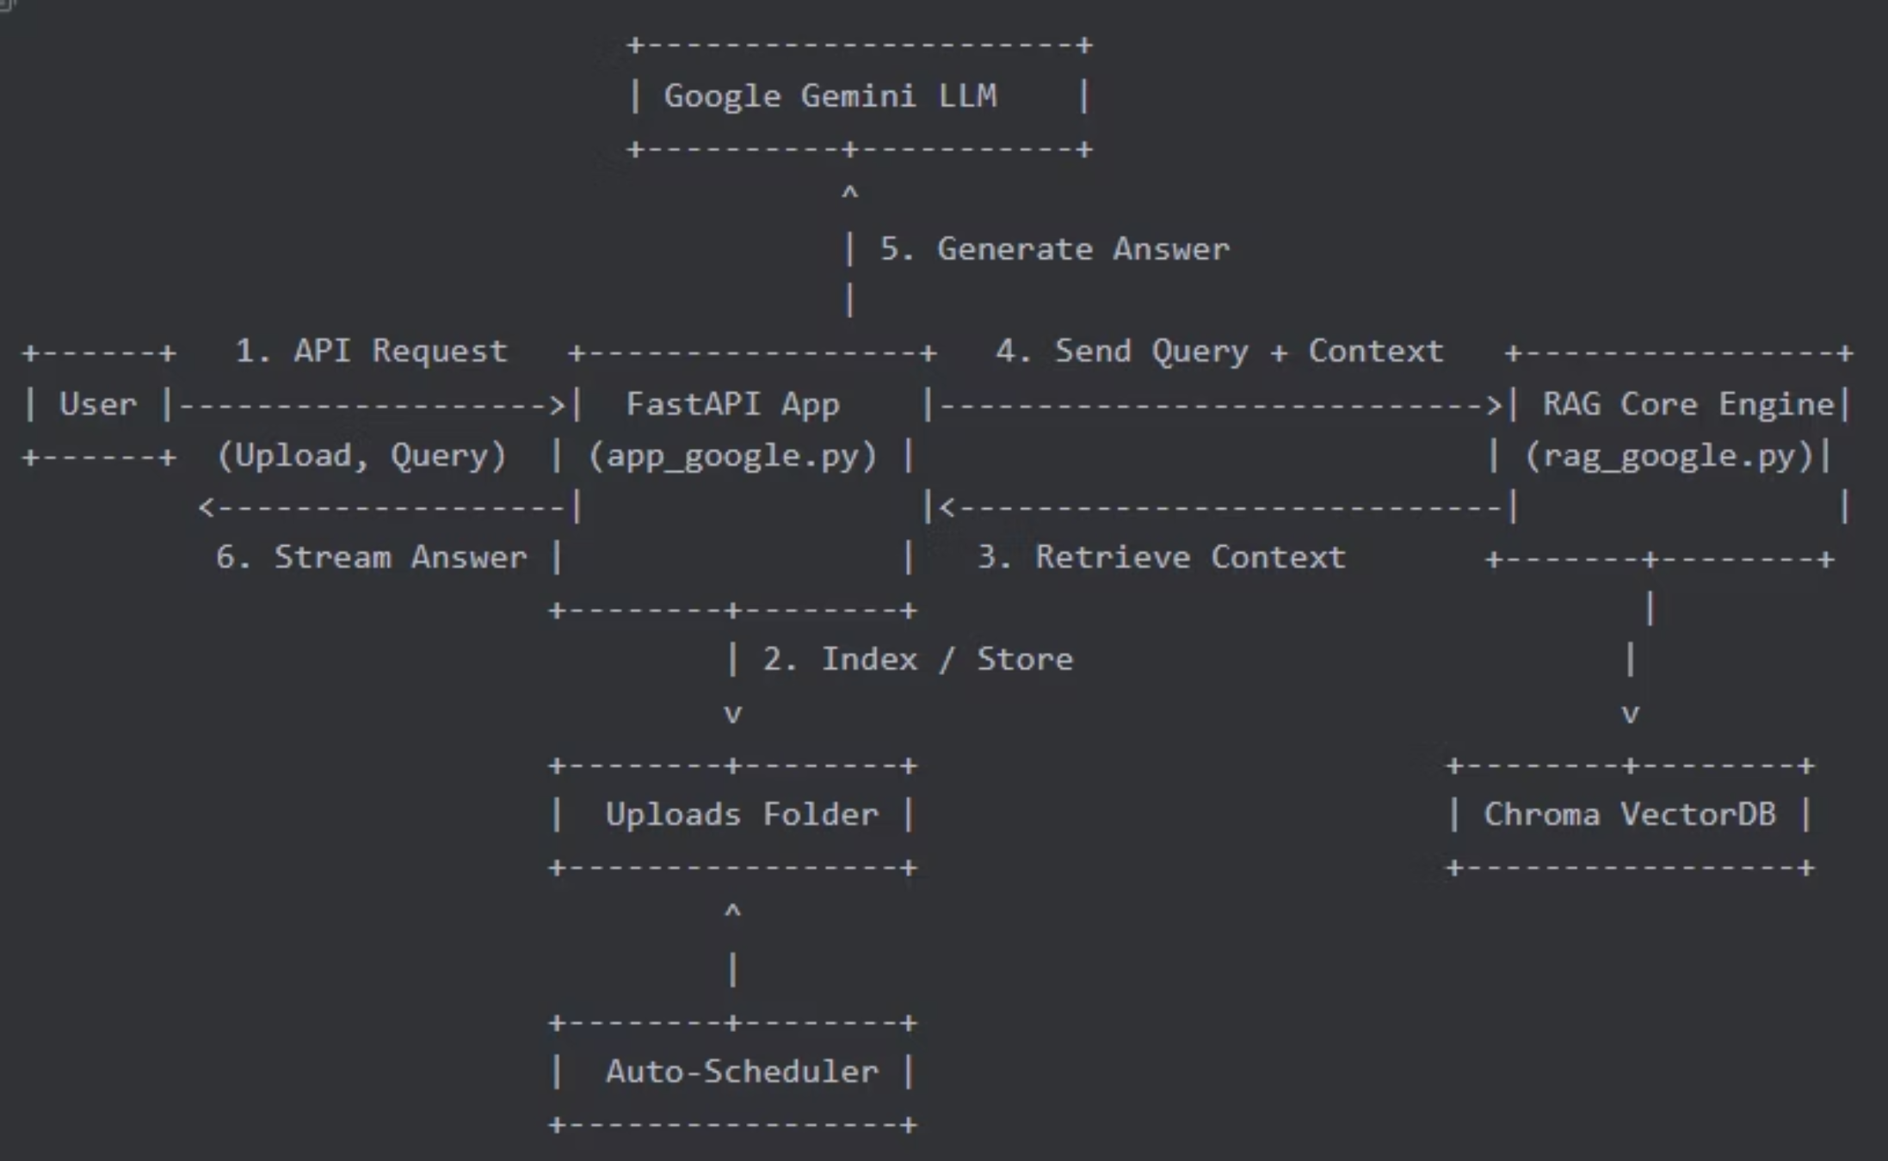
System Architecture
The diagram shows the complete flow of our RAG system, from document upload through processing to query answering, with automatic background indexing keeping everything up to date.

Slide 6



The Core Engine (rag_google.py)
This module contains the fundamental logic for our RAG pipeline.
1. Load & Chunk
2. Vectorize & Store
3. Retrieve
(load_docs, chunk_docs)
(add_to_vectorstore)
(retrieve)
Accepts .pdf and .docx files.
Uses Google's text-embedding-004 model to convert each text chunk into a numerical vector (an "embedding").
When a query comes in, it's also converted to a vector.
Splits large documents into smaller, overlapping text "chunks" (~1200 characters). This is crucial for finding precise context.
ChromaDB performs a "cosine similarity" search to find the text chunks with vectors most similar to the query's vector.
Stores these vectors in our persistent ChromaDB vector store.
Filters out results below a relevance threshold (0.5) to ensure quality.

Slide 7
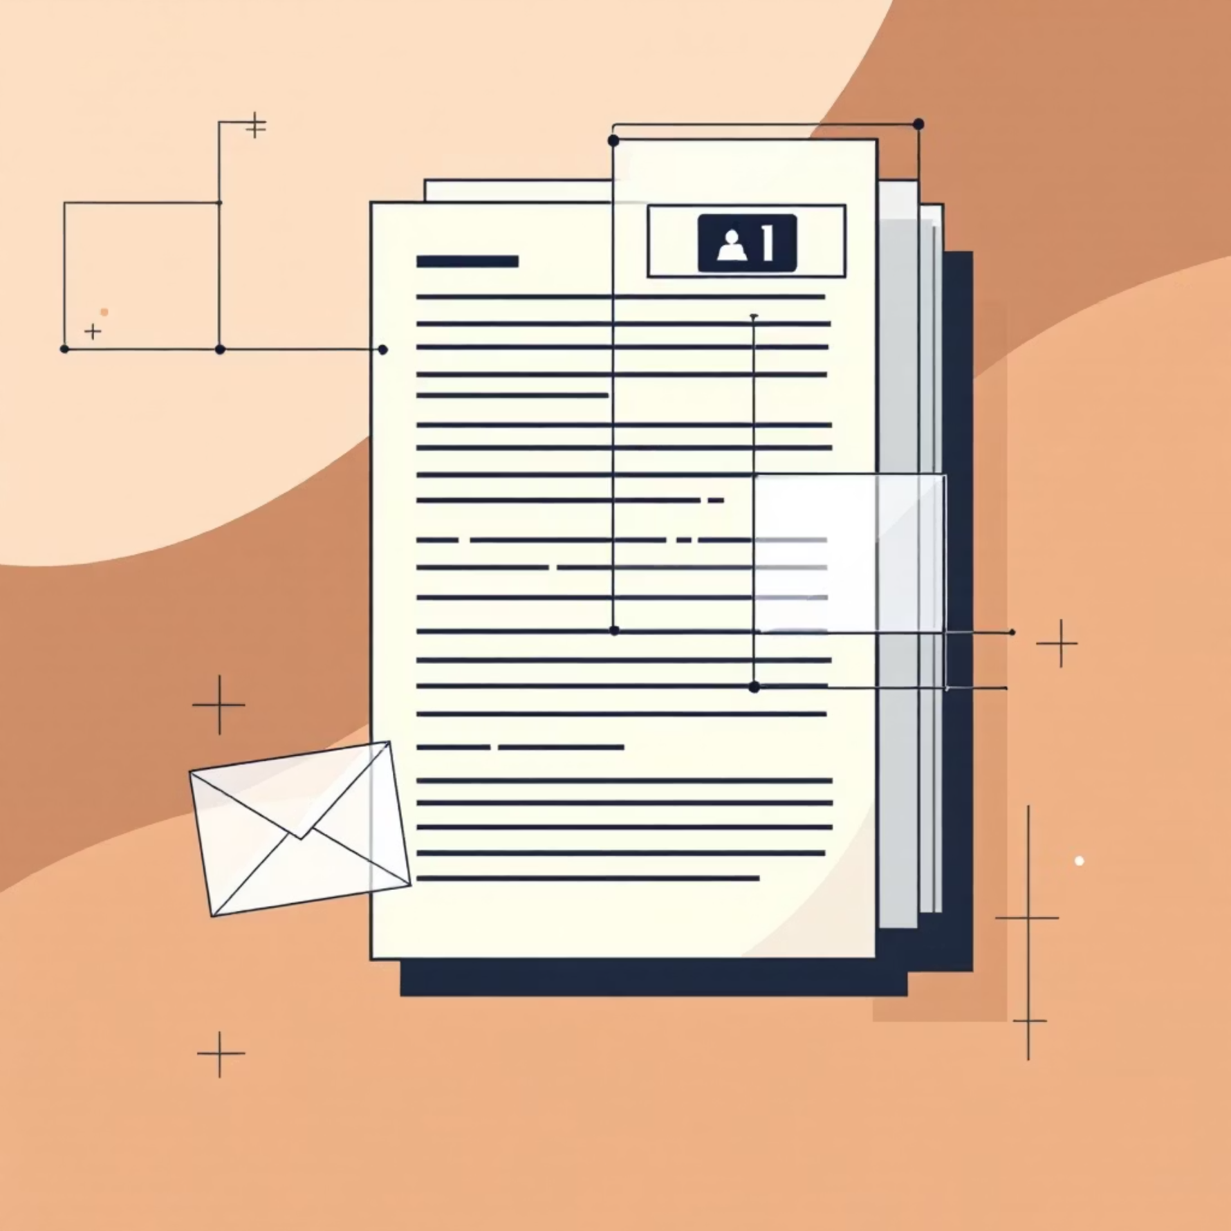
Core Engine: Smart Generation & Security
Our generation process is more than just asking a question.
answer_query_with_context function:
Example of PII Masking:
Context-Augmented Prompting
Name: John Smith -> J*** S***Email: test@example.com -> t***@example.comPhone: 123-456-7890 -> ***-***-**90
The retrieved text chunks are dynamically inserted into a carefully crafted prompt. The LLM is instructed to answer based only on this context.
PII Masking
This is a critical security and privacy feature built directly into the generation step.
Before generating the final answer, the prompt instructs the LLM to identify and mask Personally Identifiable Information (PII) in a granular way.

Slide 8

The API Layer (app_google.py)
This FastAPI application serves as the user-friendly interface to our RAG engine.
POST /upload:
POST /query:
DELETE /documents:
Accepts one or more files.
Accepts a JSON body: {"q": "your query here"}.
Accepts a list of file paths.
Saves them to the uploads/ directory.
Removes the corresponding document chunks from the vector store and our internal state file.
Immediately triggers the indexing process for the new files.
Orchestrates the retrieval and generation process.
Streams the LLM's response back in real-time for a better user experience.

Slide 9

Key Feature: Automated Indexing
The system is designed to be low-maintenance and always up-to-date.
Background Scheduler (apscheduler)
Startup Scan
A background job runs automatically every 5 minutes.
When the API server starts, it immediately scans the uploads/ folder for any new or modified files and indexes them.
It re-scans the uploads/ folder.
Modified Files
New Files
If a file has been changed (based on its modification time), the old version is deleted from the vector store and the new version is indexed.
If a new file is found, it's loaded, chunked, and added to the vector store.
Benefit: We can simply add, update, or replace files in the uploads folder, and the RAG system will automatically sync its knowledge base without any manual intervention.

Slide 10
Workflow / Demo & Configuration
Workflow / Demo
Configuration & State
01
config_google.json:
Add a Document
A single file to manage all important settings:
Place a new .pdf or .docx file into the uploads directory.
Google API Key
(Wait for the scheduler to run, or restart the server to trigger the startup scan).
LLM and Embedding model names
02
Chunking parameters (chunk_size, chunk_overlap)
Ask a Question
Retrieval parameters (k, min_relevance)
Storage directory paths
Use a tool like Postman or curl to send a POST request to the /query endpoint.
Endpoint: http://:8002/query
storage/index_state_google.json:
Body: {"q": "What is the main conclusion of the project report?"}
This file acts as the "memory" for the auto-indexing feature.
03
It keeps a record of every file that has been indexed and its last modification time. This is how the scheduler knows if a file is new or has been updated.
Receive the Answer
The API will stream back a text response, generated by Gemini, based on the content of the document you just added.
Next Steps
Building a simple web-based UI for uploads and queries.
Adding support for more file types (e.g., .txt, .pptx).
Implementing user authentication and authorization.
Experimenting with more advanced retrieval strategies (e.g., HyDE, re-ranking).
Thank You!

Slide 11
